Slide 1
Nomenclature of Heterocyclic Compounds
Naming monoheterocyclic compounds with more than one heteroatoms
1.
Name:
Prefix- Suffix – ring size - saturation
O ox
S thi
N az
Ring Size unsaturated saturated saturated ring with nitrogen
5 ole olane -olidine
6 ine inane (-ane)
O Oxa
S Thia
N Aza
Priority

Slide 2
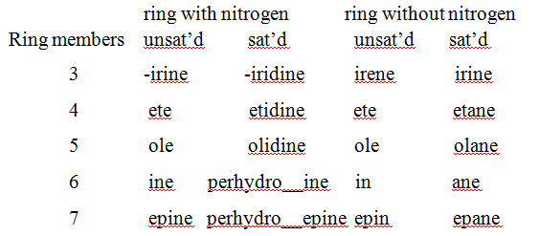

Slide 3
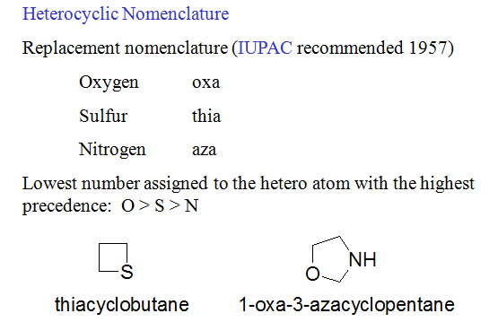

Slide 5
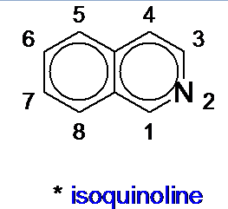
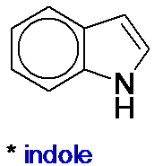
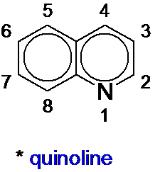

Slide 6
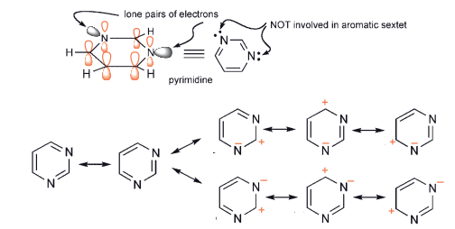
Structure of Diazin

Slide 8
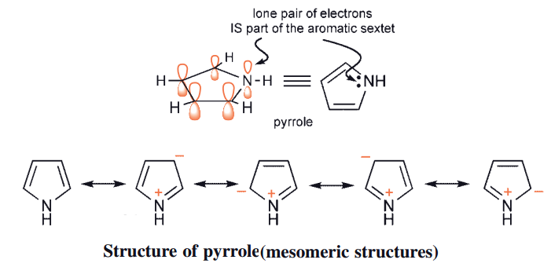

Slide 9
